Slide 1


Recitation 0.5
11-785 Introduction to Deep Learning Fall 2026
Nayesha Gandotra
Slides from many of the great TAs before me!

Slide 2

Why do we need Conda?
What is Conda?
Notebooks & Conda Environments
Installing conda on Mac, Linux and Windows
Creating & Activating conda environments
Basic conda commands
Notebooks

Slide 3

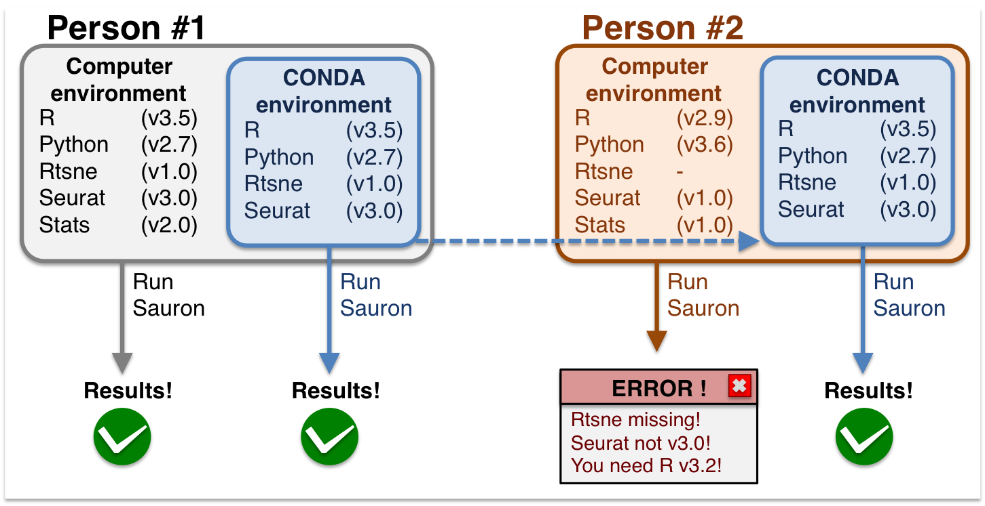
Why do we need Conda?
Run HW1P1
Run HW1P1
Run HW1P1
Run HW1P1
Image from https://nbisweden.github.io/workshop_omicsint_ISMBECCB/conda_instructions.html

Slide 4
Why do we need Conda?
Packages are reusable code modules (e.g., numpy, Pytorch).
Common Problems:
Conflicting Library Versions:
Project A needs numpy 1.26
Project B only works with 1.21
“Works on My Machine” Syndrome
Reproducibility of Research Experiments
Environments are isolated mini-systems, each containing its own specific Python version and packages.

Slide 5
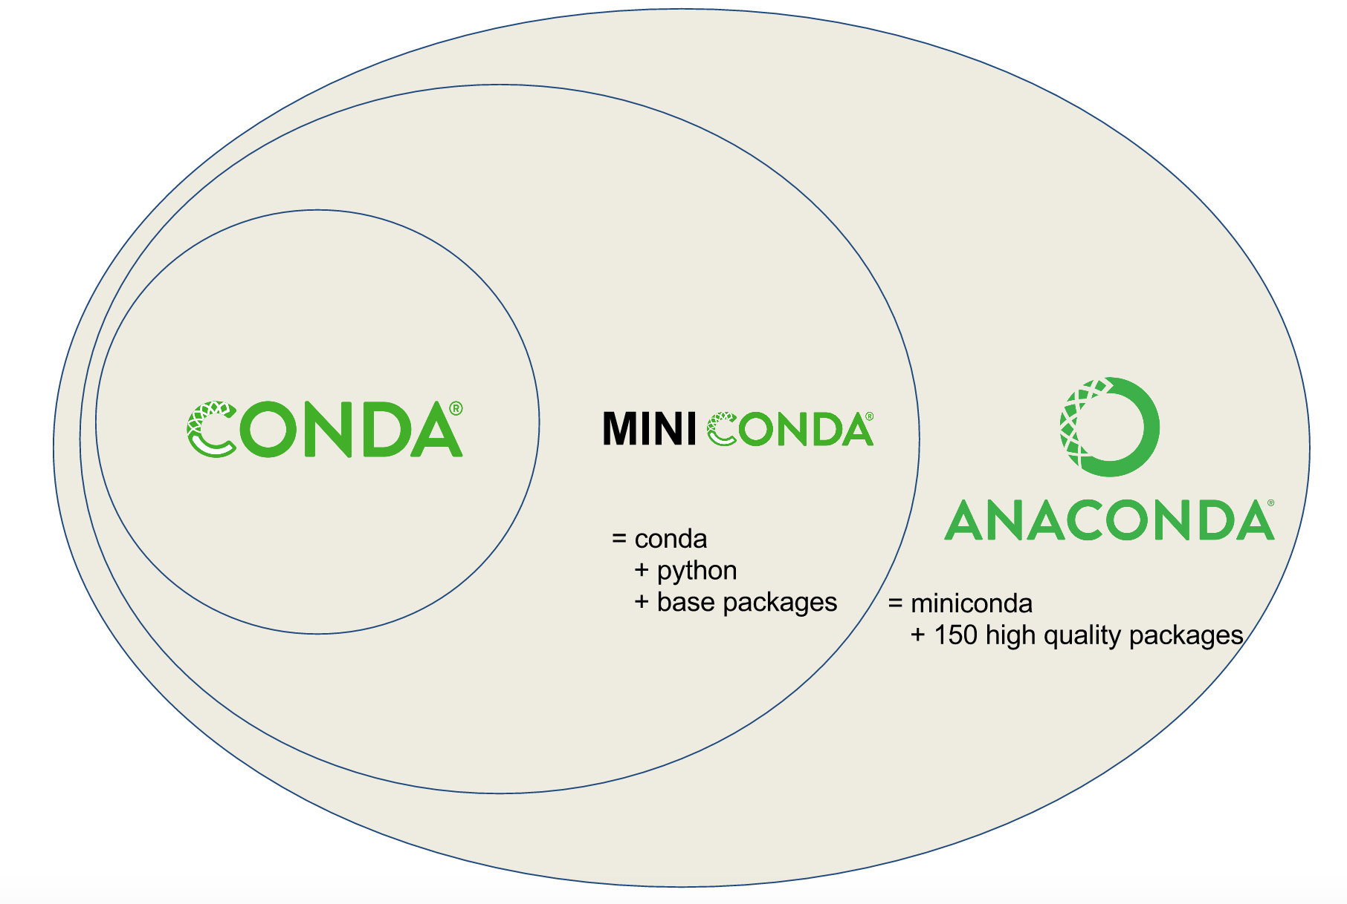
What is Conda ?
Features:
Conda is an open-source, cross-platform package management and environment management tool used in ML, DL, and software development.
Package Management
Environment Management
Broad Package Support
Cross-Platform Support
Getting started with conda

Slide 6
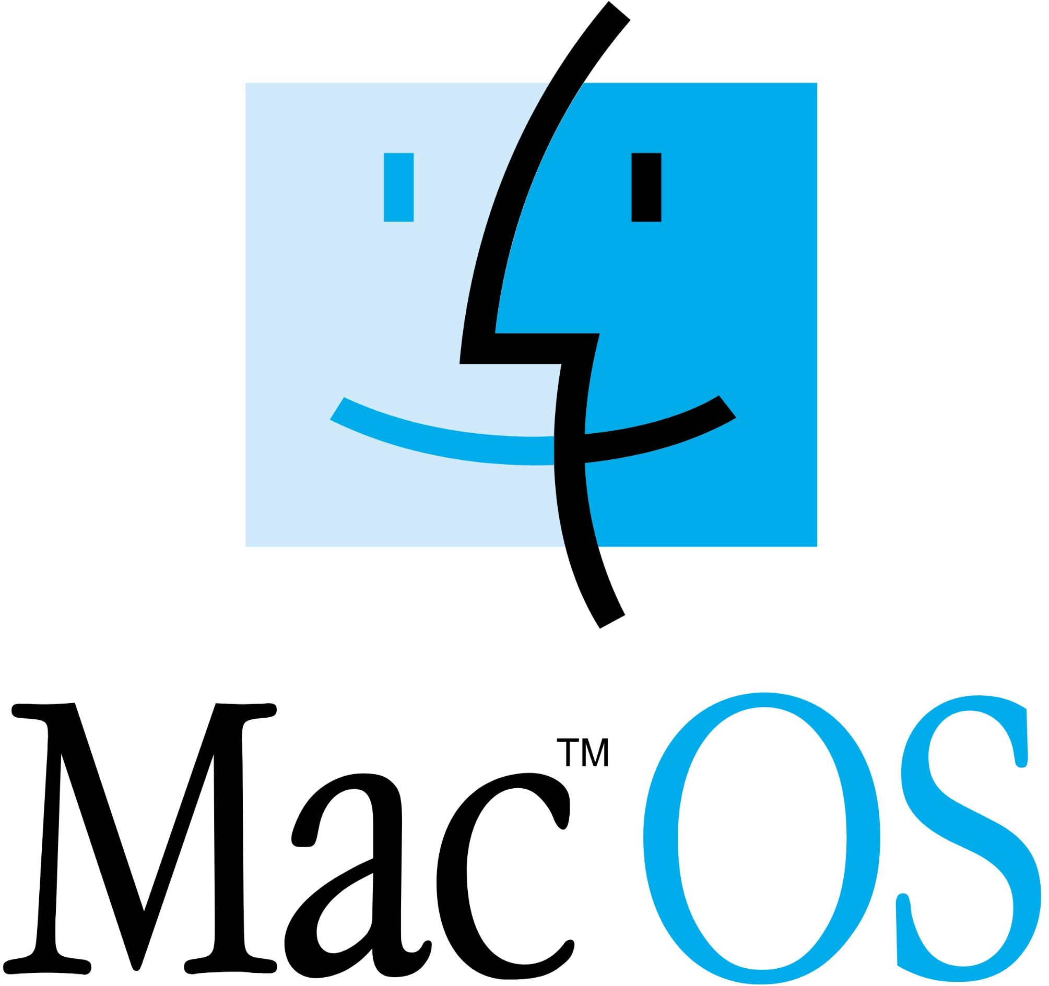


Installing Conda on Windows, Mac and Linux
Windows
Mac
Linux
Installing conda
wsl on windows

Slide 7
Creating & Activating Environment
Create:
conda create -n IDL_S26 python=3.9
Activate:
conda activate IDL_S26
Delete:
conda env list
conda deactivate
conda remove -n IDL_F26 --all

Slide 8




Notebook
Notebooks are interactive documents that let you write and run code in small chunks (cells) while mixing it with text, images, and visualizations in the same file.
Popular Notebook Platforms:
Kaggle
Google colab
Jupyter
Keep watching recitations for more content…

Slide 9
Thank You!

